Slide 1


Overcoming Barriers in a Just Culture
Cody Ferre
09/26/2024
CSD380-O302

Slide 2
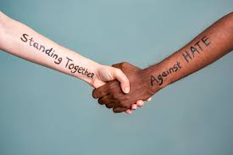
What Barriers are in place?
The barriers we feel as people can come from many different sources.
This example is of social barriers, but we also have culture, conceptual, linguistic and even professional.
A first place to start when overcoming any cultural differences is acceptance. Of others, of their backgrounds, everything.

Slide 3
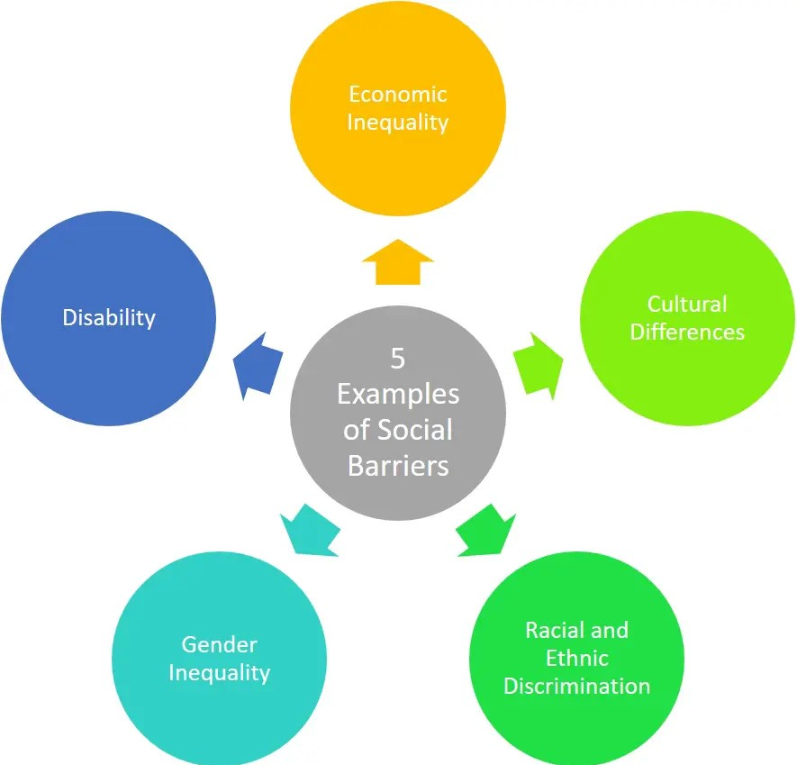
Social and cultural Barriers
The social barriers we overcome are based on people's assumptions over their beliefs, values, habits and attitudes.
Overcoming this would be accepting people for who they are, that acceptance should be built on trust.
That trust can be built up and eroded quickly

Slide 4
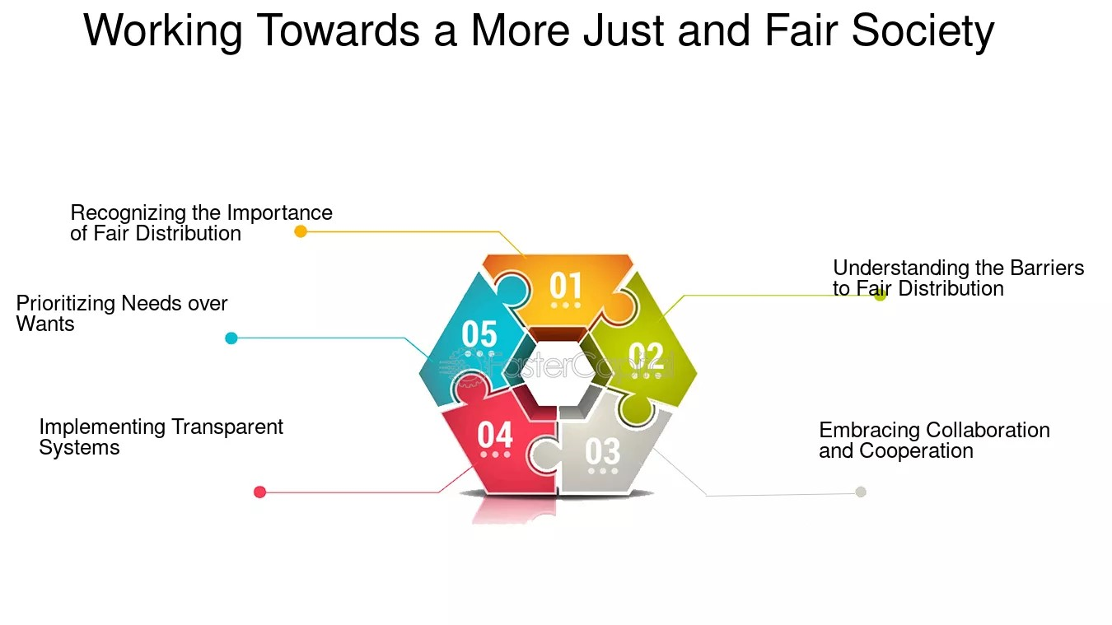
Linguistic and professional barrier
Languages can limit our confidence in interaction but also shapes a lot of our social habits.
HQCA says that part of being human is having bias towards an outcome and the same goes when we are unable to communicate.
For Professionals, we tend to follow standards that are apart and somewhat disconnected from the culture that we are around.
For example, Safety culture are established with a base, while work culture can change depending on the culture its located in. Ex. China, US .

Slide 5
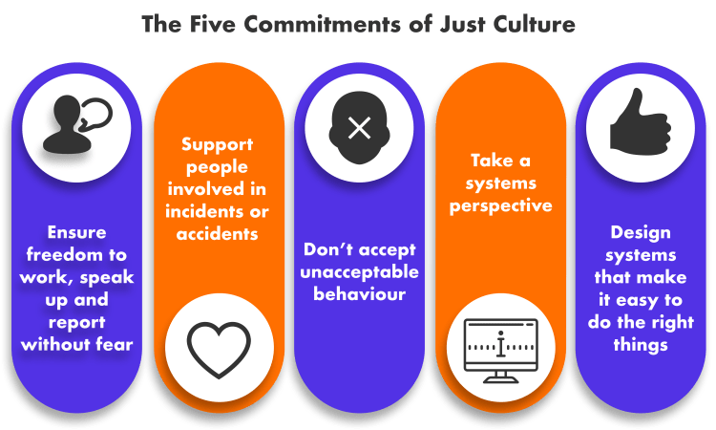
Overcoming and Understanding
To create a just culture is to identify the needs of people and then help them gain access to those needs.
An overall better culture means also a better culture for each aspect. Increasing aid when its needed.
A bond of trust is needed in order to uphold the culture and keep it just.

Slide 6
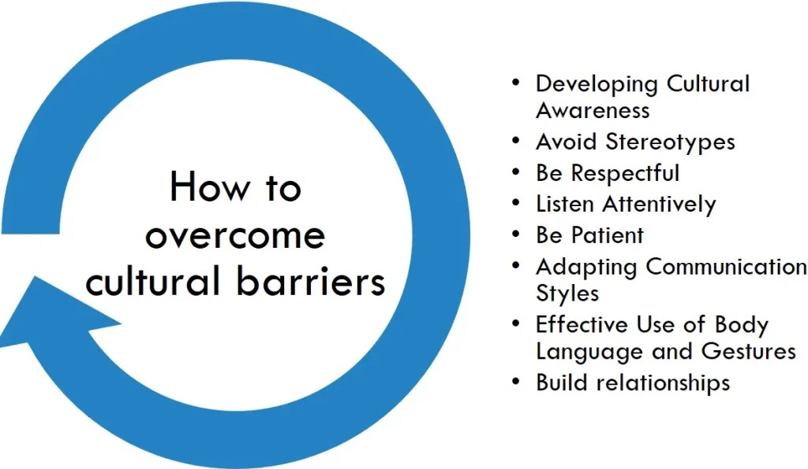
Overcoming barriers

Slide 7
Citations
Steven Shorrock, October 18, 2023, Why is it Just so Difficult? Barriers to 'Just Culture' in the Real World, Humanistic Systems, https://humanisticsystems.com/2023/10/18/why-is-it-just-so-difficult-barriers-to-just-culture-in-the-real-world/
Sjoerd Van Marum, Daan Verhoeven, Diederik de Rooy, The Barriers and Enhancers to trust in a just culture in hospital settings: a systematic review, pubmed, https://pubmed.ncbi.nlm.nih.gov/35588066/
2024, Overcoming Barriers to a Just Culture, Health quality council of Alberta, https://justculture.hqca.ca/overcoming-barriers-to-a-just-culture/
Alison H. Page, October 1, 2007, Making just culture a reality: One organization's approach, https://psnet.ahrq.gov/perspective/making-just-culture-reality-one-organizations-approach

